Slide 1
The Ten Commandments of Continuous Delivery
Viktor Farcic

Slide 2
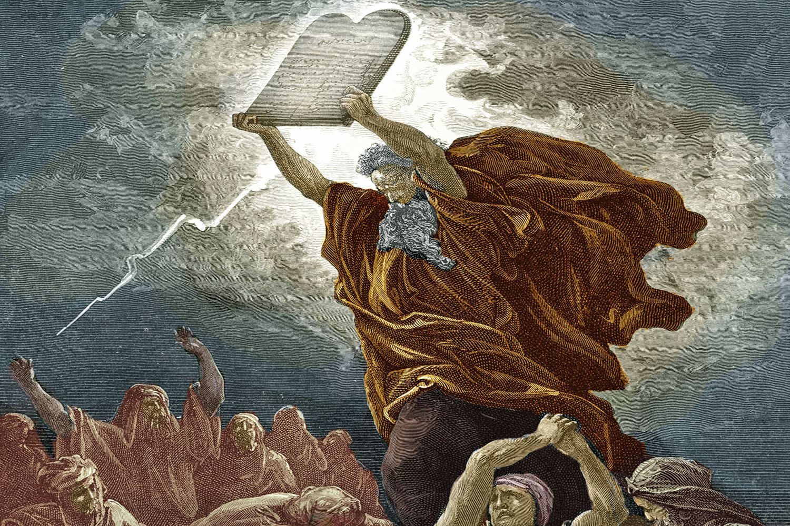
The Ten Commandments of Continuous Delivery

Slide 3
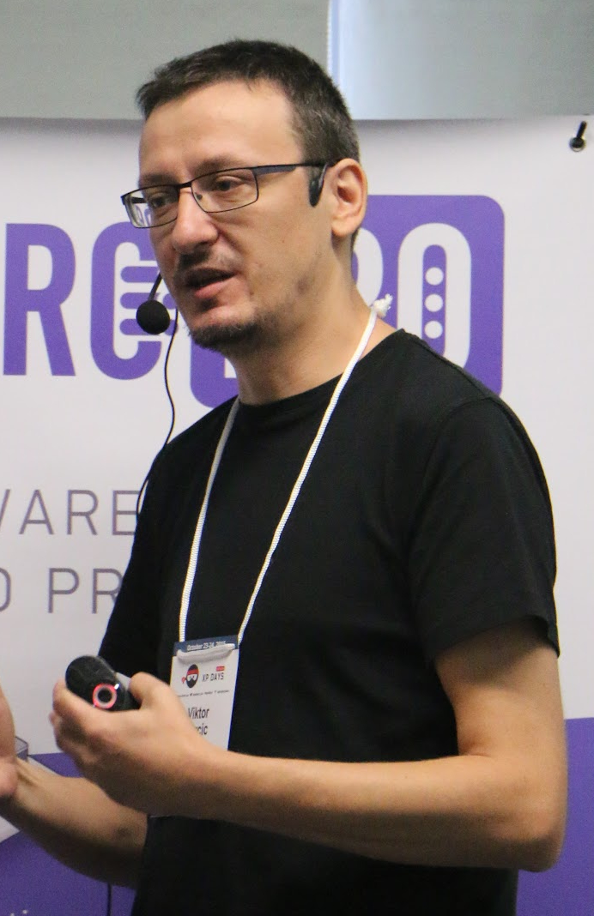
Viktor Farcic
Presenter

Slide 4

Viktor Farcic
Presenter

Slide 5

Viktor Farcic
Presenter

Slide 6

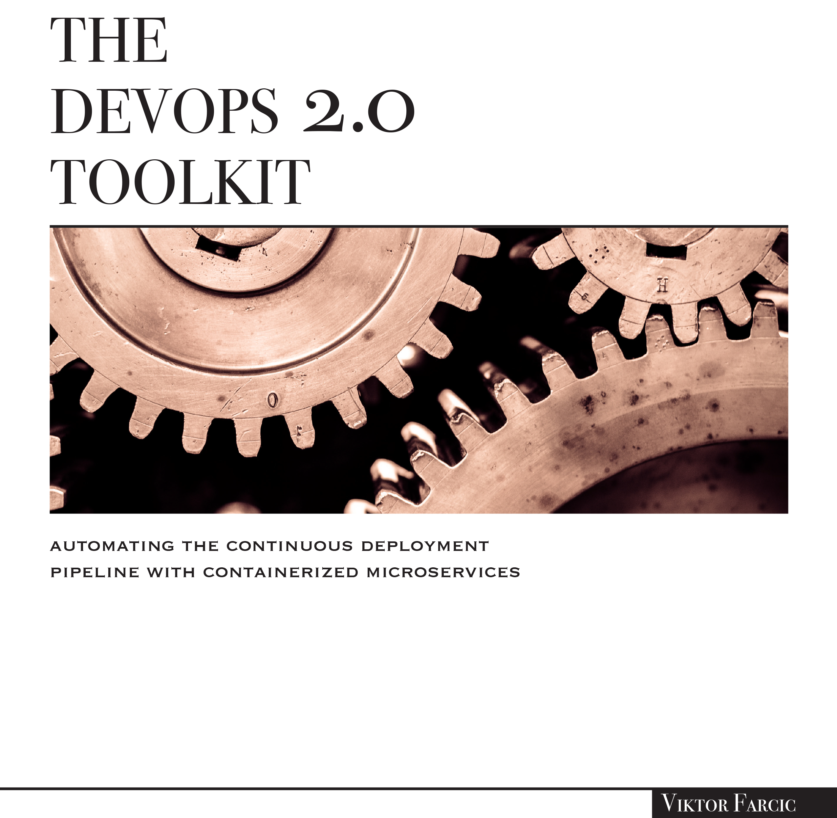

Viktor Farcic
Presenter

Slide 7

Why Am I Here?

Slide 8

Relaxing

Slide 9

Epiphany

Slide 10

Denied Boarding

Slide 11
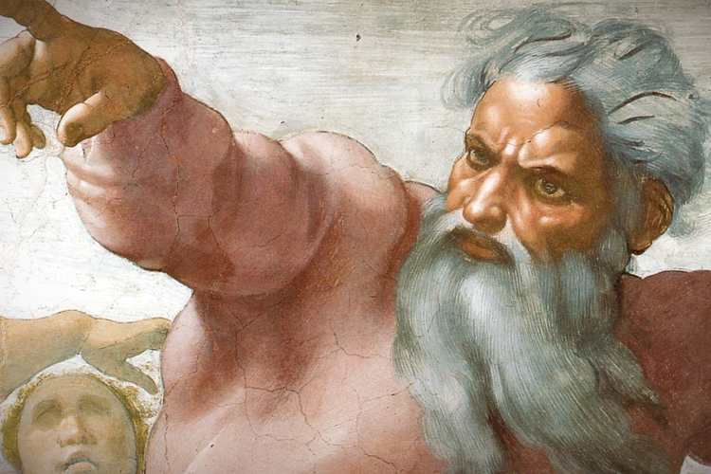
Not my views

Slide 12

Continuous Delivery
You want it
You claim you’re doing it
You failed or you’re faking it

Slide 13

Continuous Delivery
… or you’re
a minority

Slide 14
I. Thou Shalt Be Agile

Slide 15
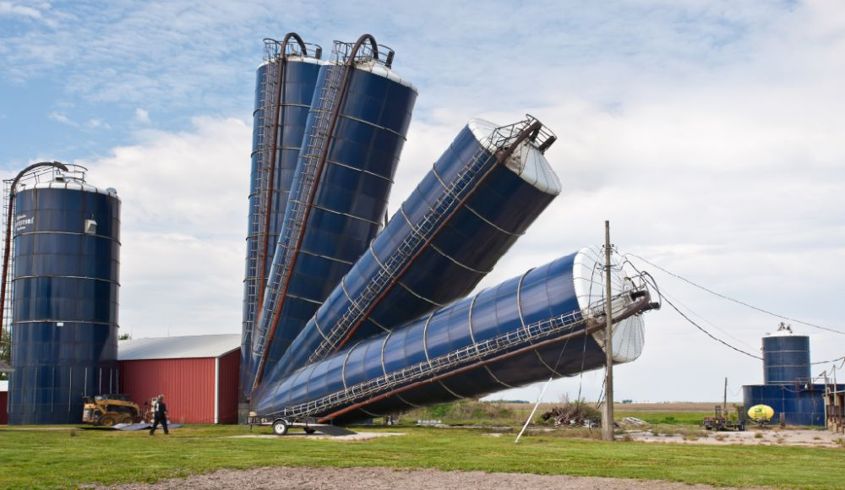
No deparments, no silos

Slide 16
II. Thou Shalt Refactor

Slide 17

Reachitecture your pile of **** into testable code

Slide 18
III. Thou Shalt Educate Others

Slide 19

No CD department

Slide 20
IV. Thou Shalt Be Small

Slide 21

Split monoliths

Slide 22
V. Thou Shalt Practice TDD

Slide 23

No tests, no commits

Slide 24
VI. Thou Shalt Define Your CD Pipeline As Code

Slide 25

No more clicking around

Slide 26
VI. Thou Shalt Have A Fast Pipeline

Slide 27

One coffee, not longer

Slide 28
VII. Thou Shalt Consider Fixing A Failed Pipeline As Highest Priority

Slide 29
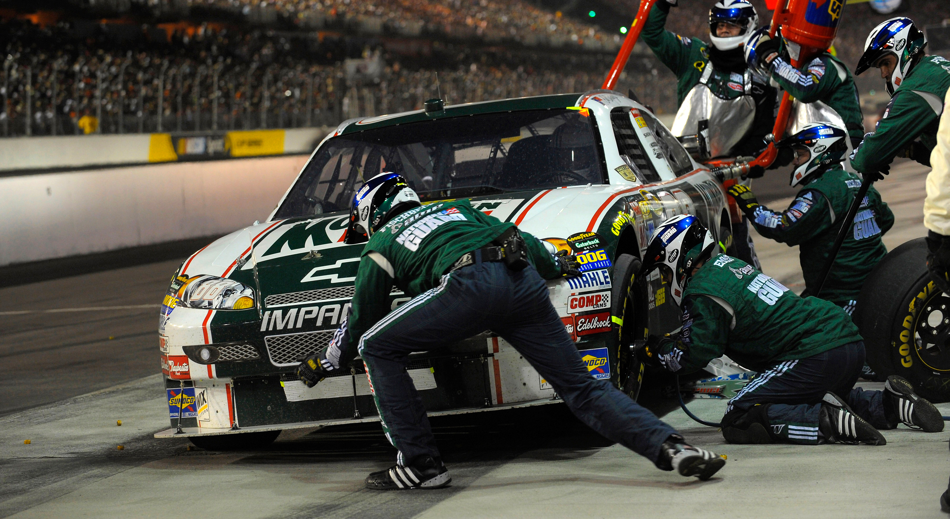
Fix it first, drive later

Slide 30
IX. Thou Shalt Run The CD Pipeline Locally

Slide 31

Respect your coworkers

Slide 32
X. Thou Shalt Commit Only To The Master Branch

Slide 33

The master is the only one that matters

Slide 34

What now?

Slide 35

Viktor Farcic
@vfarcic
TechnologyConversations.com

Slide 36
The DevOps Toolkit Series

